Slide 2
learn aggregate data models.

Slide 3
Data Model
A data model is a representation that we use to perceive and manipulate our data.
It allows us to: –
  Represent the data elements under analysis, and
  How these are related to each others .
This representation depends on our perception.

Slide 4
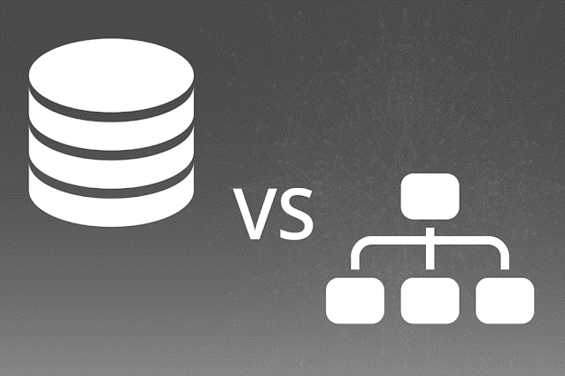
Data Model
Database | Storage Model
How we interact with the data in the database | How the database stores and manipulates the data internally
Database is distinct from storage model

Slide 5
Data Models: Example
A Data model is the model of the specific data in an application
A developer might point to an entity-relationship diagram and refer it as the data model containing – customers,
– orders and
– products

Slide 6
Data Model
Q: What is the name of data model from last couple of decades?
Ans:-????

Slide 7
Data Model
Q: What is the name of data model from last couple of decades?
Ans:- Relational data model

Slide 8
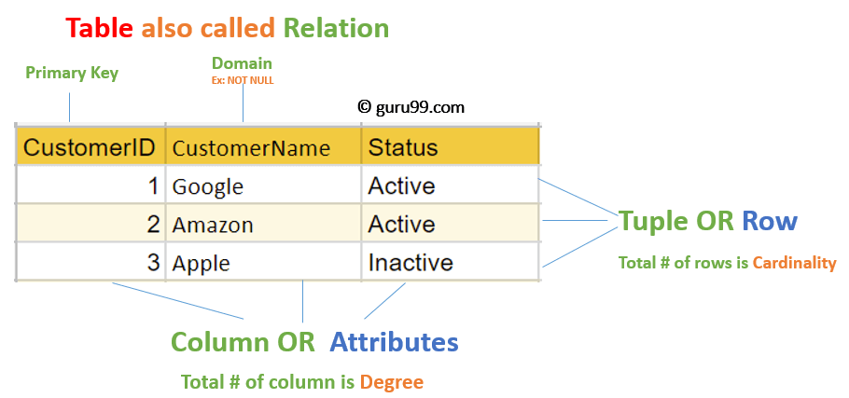
Data Model

Slide 9
NoSQL Data Model
It moves away from the relational data model.
Each NOSQL database has a different model
  Key-value
  Document
  Column-family
  Graph, and
  Sparse (Index based)
Of these, the first three share a common characteristics (Aggregate Orientation).

Slide 10
Relational Model
vs
Aggregate Data Model

Slide 11
Relational Model
The relational model takes the information that we want to store and divides it into tuples (rows).
However, a tuple is a limited data structure.
It captures a set of values.
So, we can’t nest one tuple within another to get nested records.
Nor we can put a list of values or tuple within another.

Slide 12
Relational Model
This simplicity characterize the relational model.
It allows us to think on data manipulation as operation that have: –
  As input tuples, and –
  Return tuples •
Aggregate orientation takes a different approach.

Slide 13
Aggregate data model
Relational database modelling is vastly different.
An aggregate is a collection of data that we interact with as a unit.
These units of data or aggregates form the boundaries for ACID operations with the database.

Slide 14
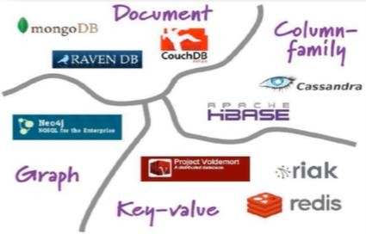
Aggregate data model
NoSQL databases are classified in different data models:

Slide 15
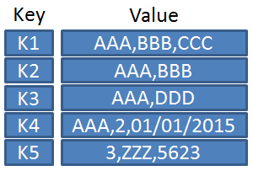
Aggregate data model
Key-value

Slide 16
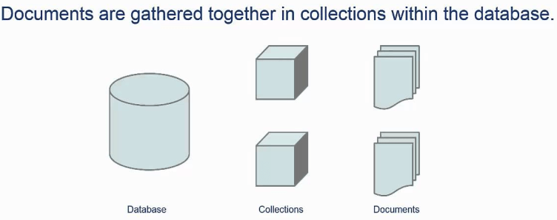
Aggregate data model
Key-value
Document Databases

Slide 17
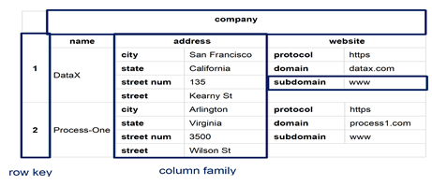
Aggregate data model
Column-family databases

Slide 18
Aggregate data model
What make it easier for the database?
Aggregates make it easier for the database to manage data storage over clusters.
Aggregate-oriented databases work best when most data interaction is done with the same aggregate.

Slide 19
Examples of Relations and Aggregates

Slide 20
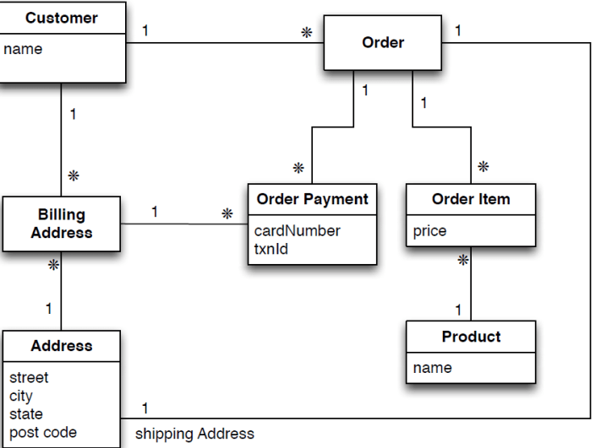
Examples of Relational Model
Assume we are building an e-commerce website;
We have to store information about: users, products, orders, shipping addresses, billing addresses, and payment data.
Data Model Oriented Around a Relational Database

Slide 21
Examples of Relational Model
As we are good relational soldier:
  Everything is normalized
  No data is repeated in multiple tables.
  We have referential integrity
Data Model Oriented Around a Relational Database

Slide 22
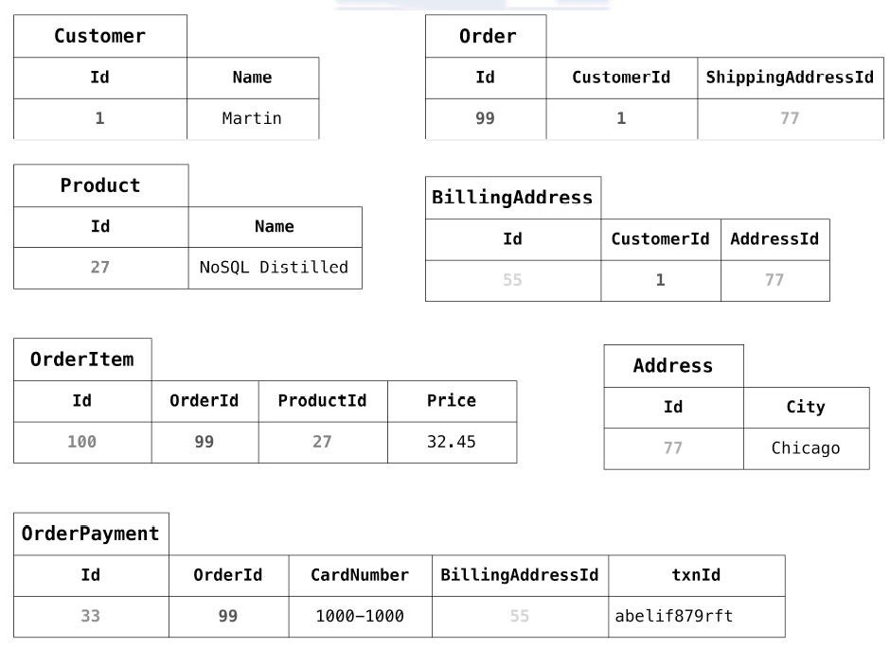
Typical data using RDBMS data model
Sample Data

Slide 23
Typical data using RDBMS data model
Sample Data for this model

Slide 24
Lets see how this model looks when we think in more aggregate-oriented terms

Slide 25
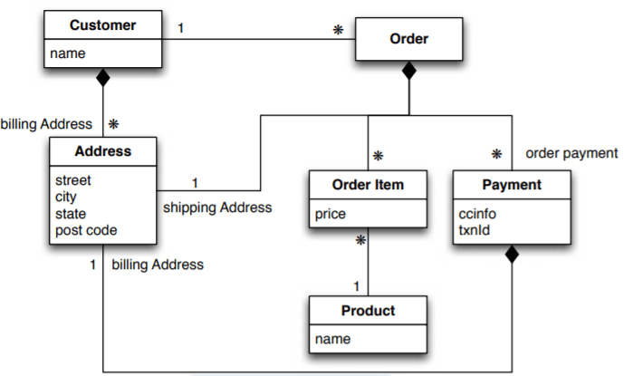
Example of Aggregate Model
We have two aggregates:
  Customers and
  Orders
We us the black-diamond composition to show how data fits into the aggregate structure
An Aggregate Data Model

Slide 26
Example of Aggregate Model
The customer contains a list of billing addresses;
The order contains a list of:
  order items,
  a shipping address,
  and payments
The payment itself contains a billing address for that payment
An Aggregate Data Model

Slide 27
Example of Aggregate Model
A single logical address appears 3 times, but instead of using IDs it is copied each time.
This fits a domain where we don’t want shipping, payment and billing address to change.
An Aggregate Data Model

Slide 28
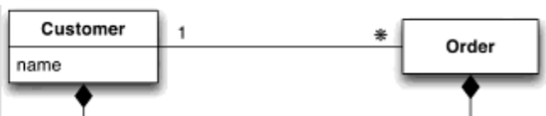
Example of Aggregate Model
The link between the customer and the order is a relationship between aggregates
//Customer { "id": 1, "name": "Fabio", "billingAddress": [ { "city": "Bari" } ] } | //Orders { "id": 99, "customerId": 1, "orderItems": [ { "productId": 27, "price": 34, "productName": “NoSQL Distilled” } ], | "shippingAddress": [ { "city": "Bari”} ], "orderPayment": [ { "ccinfo": "100-432423-545-134", "txnId": "afdfsdfsd", "billingAddress": [ {"city": “Chicago” }] } ] }

Slide 29
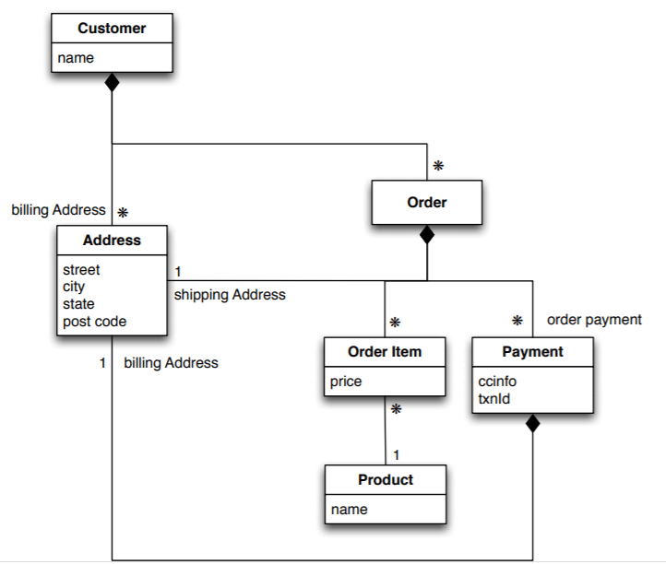
Embed all the objects for customer and the customer’s order

Slide 30
Orders Details
Orders { "id": 99, "customerId": 1, "orderItems": [ { "productId": 27, "price": 34, "productName": “NoSQL Distilled” } ], "shippingAddress": [ {"city": “Chicago”} ], "orderPayment": [ { "ccinfo": "100-432423-545-134", "txnId": "afdfsdfsd", "billingAddress": [ {"city": “Chicago” }] } ] } | There is the customer id The product name is a part of the ordered Items. The product id is part of the ordered items. The address is stored several times.

Slide 31
CONSEQUENCES OF AGGREGATE
MODELS

Slide 32
CONSEQUENCES OF AGGREGATE MODELS
Relational mapping captures various data elements and their relationships.
Order consist of
  Oreder items, a shipping address, and a payment
All can be expresses in the relational model in terms of foreign key relationships.

Slide 33
Important
The database can’t use a knowledge of aggregate structure to help it store and distribute the data.

Slide 34
Marking Aggregate Tools
Many data modeling techniques provides way to mark aggregate structures in relational models.
However, they do not provide semantic that helps in distinguish relationships.
When working with aggregate-oriented databases, we have a clear views of the semantic of the data.
We can focus on the unit of interaction with the data storage.

Slide 35
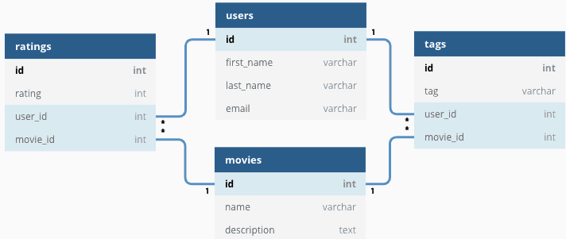
Aggregate Ignorant
Relational Database

Slide 36
Aggregate Ignorant
Relational Database
Aggregate Ignorant

Slide 37
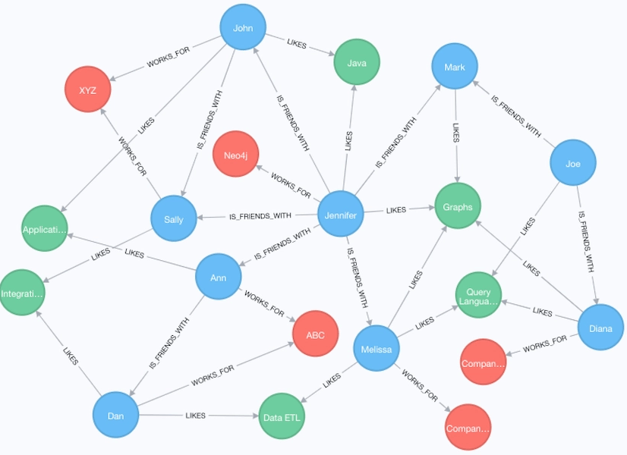
Aggregate Ignorant
Graph Database are aggregate-ignorant

Slide 38
Aggregate and Operations
An order is a good aggregate when:
  A customer is making and reviewing an order, and – When the retailer is processing orders •
However, when the retailer want to analyze its product sales over the last months, then aggregate are trouble. •
We need to analyze each aggregate to extract sales history.

Slide 39
Aggregate and Operations
Aggregate may help in some operation and not in others.
In cases where there is not a clear view aggregate ignorant database are the best option. •
But, remember the point that drove us to aggregate models (cluster distribution).
Running databases on a cluster is need when dealing with huge quantities of data.

Slide 40
What is the clinching reason for aggregate orientation?

Slide 41
Running on a Cluster
It gives several advantages on computation power and data distribution
However, it requires to minimize the number of nodes to query when gathering data.
By explicitly including aggregates, we give the database an important of which information should be stored together .

Slide 42
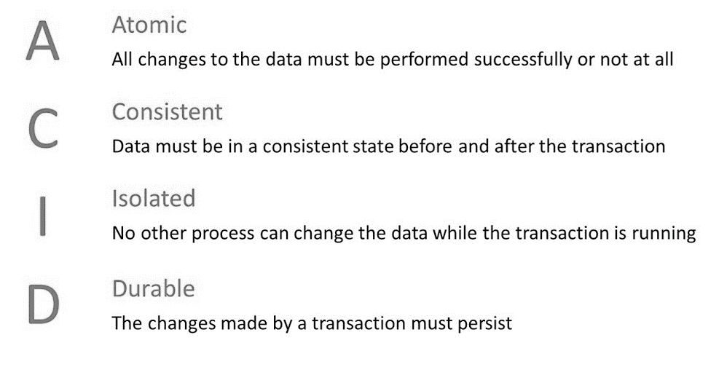
How Aggregates plays an important consequence for transactions?

Slide 43
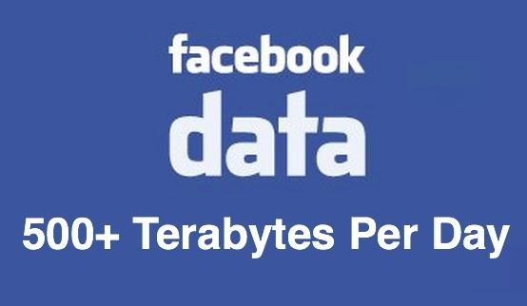
Why data consistency is not required?

Slide 44
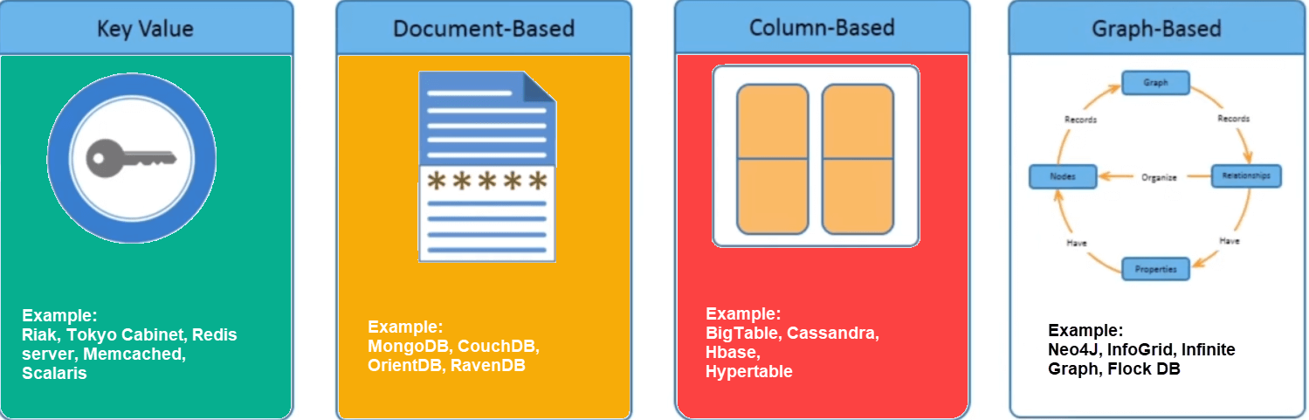
Types of NoSQL databases

Slide 45
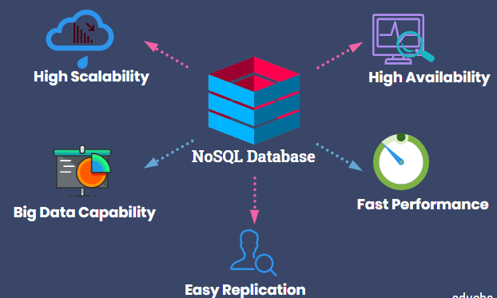
NoSQL databases

Slide 46
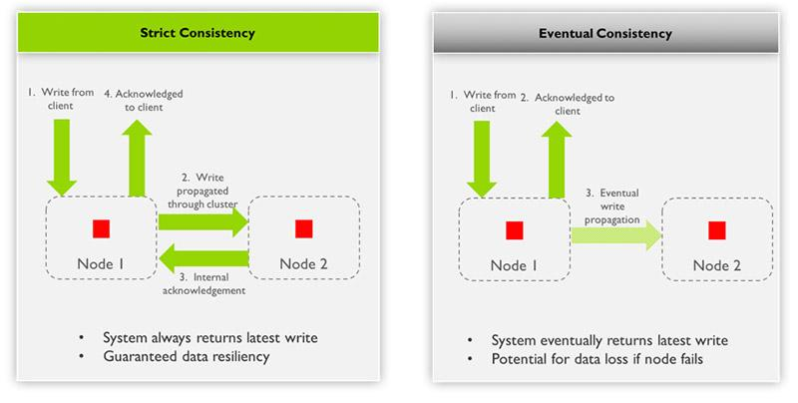
Types of NoSQL databases

Slide 47
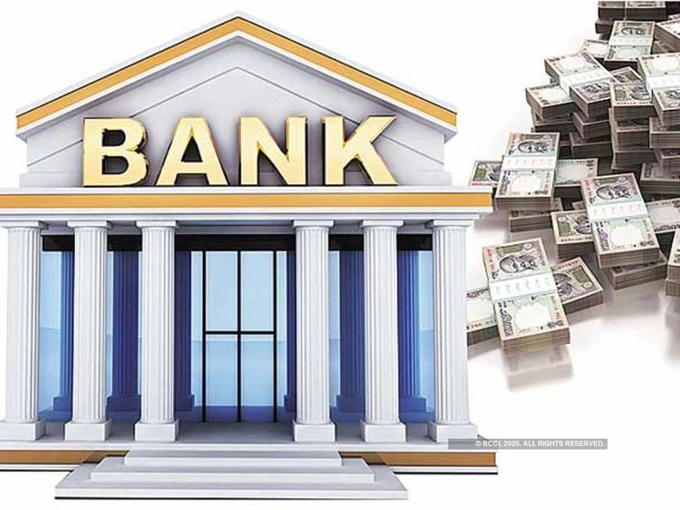
NoSQL databases
Bank account data must be consistent whenever any updates are made to data.

Slide 48

NoSQL databases
Online multiplayer gaming applications usually store profile data of a large number of users that require strong consistency.

